Slide 1


Employee Management
System

Slide 2

STUDIO SHODWE
Introduction To Our Project
An EMS is crucial for modern businesses to manage their human resources effectively, ensuring productivity, compliance, and employee satisfaction..
An Employee Management System (EMS) is a software solution designed to help organizations manage their workforce efficiently.

Slide 3

STUDIO SHODWE
About EMS
Efficiency and Productivity
Automation of Routine Tasks
Streamlined Processes
Employee Satisfaction and Engagement

Slide 4


STUDIO SHODWE
Project Vision And Mission
Vision
Mission
To revolutionize workforce management by providing innovative, comprehensive, and user-friendly solutions that empower organizations to optimize their human resources, foster employee engagement, and achieve excellence in operational efficiency.
To deliver cutting-edge employee management systems that streamline HR processes, enhance data accuracy, ensure compliance, and support the growth and development of employees, enabling organizations to thrive in a competitive landscape.

Slide 5
STUDIO SHODWE
Employee Management System Service
01
Easy maintenance of employee data
02
Employee Track record storage
03
Empty the database if employee record deleted
04
To review and employee record

Slide 6
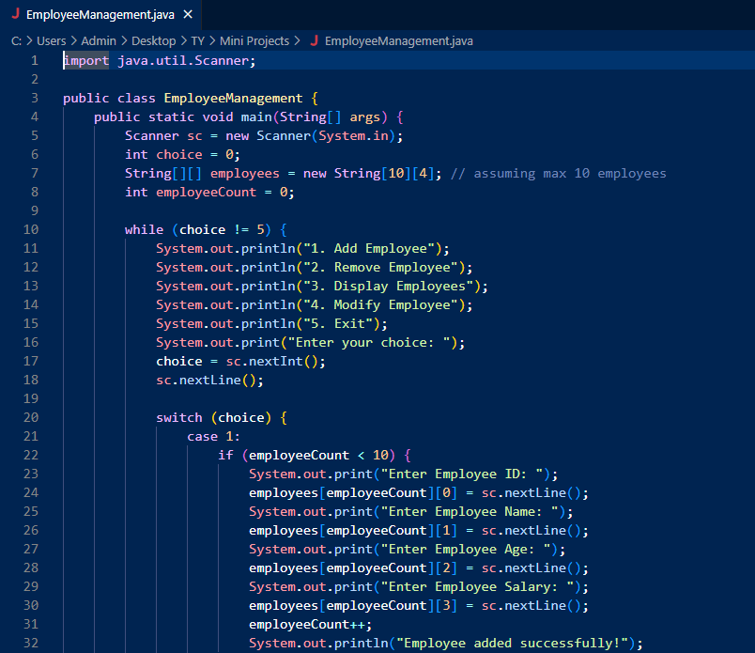
SOURCE CODE EXPLAINATION:

Slide 7
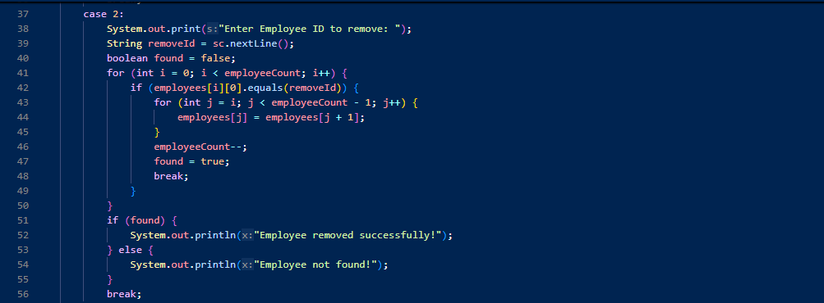
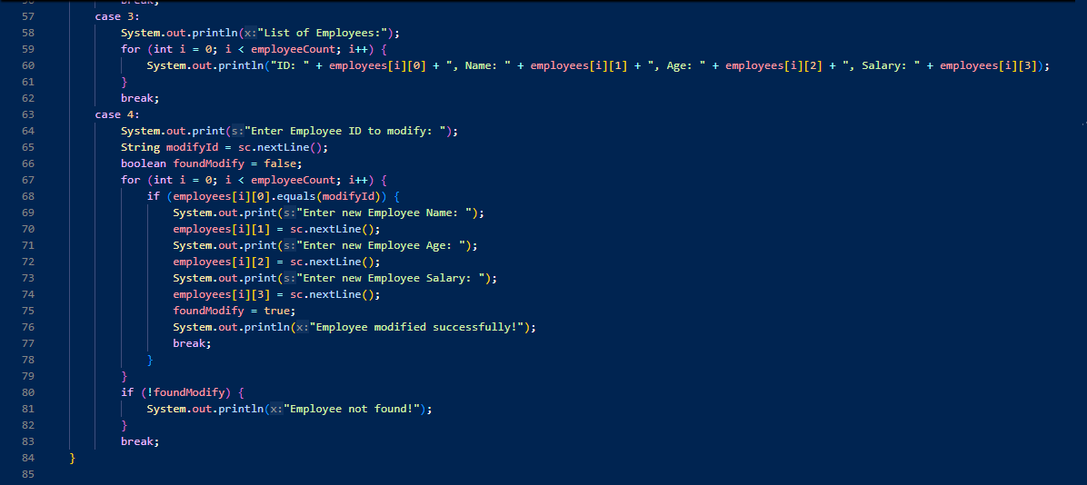

Slide 8
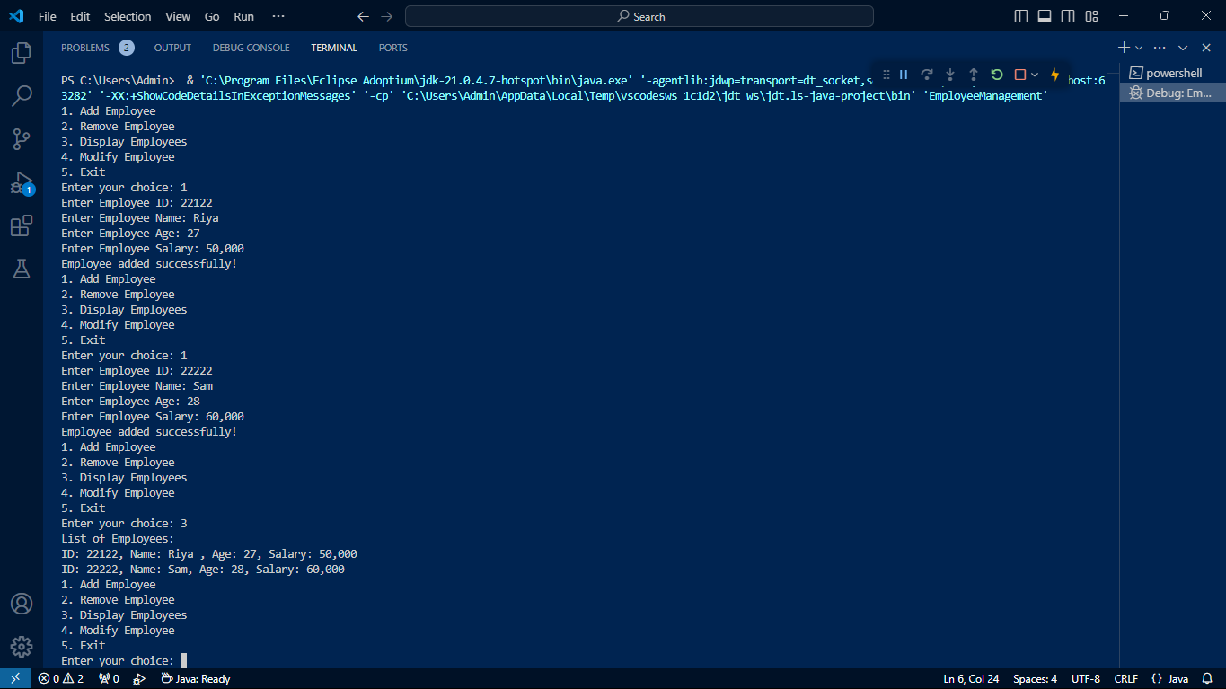

Slide 9
